Slide 1
The Inflection Point Hypothesis:
A Principled Debugging Approach for Locating the Root Cause of a Failure
Yongle Zhang, Kirk Rodrigues, Yu Luo, Michael Stumm, Ding Yuan

Slide 2
The Cost of Debugging
$312 Billion
[Britton et al. 2013]

Slide 3



Root Cause – A Major Goal of Debugging
Debugging
Bug Report
Root Cause

Slide 4
Root Cause – A Major Goal of Debugging
Failure Execution
Failure Reproduction
Root Cause Localization
Bug Report
Root Cause

Slide 5
Failure Reproduction is Well Studied
Failure Execution
Failure Reproduction
Root Cause Localization
Bug Report
Root Cause
Deterministic replay
Tracing
Reproduction using log/core-dump
Hardware support (Intel-PT)

Slide 6
Root Cause Localization is Challenging
Failure Execution
Failure Reproduction
Root Cause Localization
Bug Report
Root Cause
millions ~ billions
of instructions

Slide 7
Our Goal – Automating Root Cause Localization
Failure Execution
Failure Reproduction
Root Cause Localization
Bug Report
Root Cause

Slide 8
State of The Art – Probabilistic Approach
Instruments program to record predicates
E.g., whether a branch condition (a!=0) is satisfied
Collects large number of traces
Strongest statistical correlation
Failed Executions
Succ. Executions

Slide 9
State of The Art – Probabilistic Approach
Instruments program to record predicates
E.g., whether a branch condition (a!=0) is satisfied
Collects large number of traces
Strongest statistical correlation
Failed Executions
Succ. Executions
Result is probabilistic
Requires a large number of failure executions
Lacks execution context

Slide 10
Towards Analytical Root Cause Localization
What is the fundamental property of root cause that allows us to build a tool to automatically search for it?

Slide 11
What is a Root Cause?
The most basic reason for a failure which, if corrected, would have prevented the failure from occurring.
-- Wilson et al. ASQ Quality Press 1993

Slide 12
What is a Root Cause?
1
The root cause is an instruction in the failure execution which, if changed, would have resulted in a correct execution.
2
The root cause is the most basic cause of the failure.

Slide 13
What is a Root Cause?
1
The root cause is an instruction in the failure execution which, if changed, would have resulted in a correct execution.
Thread 0
Thread 1
Time
a=0;
2
The root cause is the most basic cause of the failure.
a=-1;
if(a!=0)
FAIL;

Slide 14
What is a Root Cause?
1
The root cause is an instruction in the failure execution which, if changed, would have resulted in a correct execution.
Thread 0
Thread 1
Time
a=0;
2
The root cause is the most basic cause of the failure.
a=-1;
if(a!=0)
FAIL;

Slide 15
What is a Root Cause?
1
The root cause is an instruction in the failure execution which, if changed, would have resulted in a correct execution.
Thread 0
Thread 1
Time
a=0;
2
The root cause is the most basic cause of the failure.
a=-1;
if(a!=0)
FAIL;

Slide 16
What is a Root Cause?
1
The root cause is an instruction in the failure execution which, if changed, would have resulted in a correct execution.
Thread 0
Thread 1
Time
a=0;
2
The root cause is the most basic cause of the failure.
if(a!=0)
a=-1;

Slide 17
What is a Root Cause?
1
The root cause is an instruction in the failure execution which, if changed, would have resulted in a correct execution.
CONFIG=
FALSE;
Thread 0
Thread 1
Time
if(CONFIG)
a=0;
2
The root cause is the most basic cause of the failure.
a=-1;
if(a!=0)
FAIL;

Slide 18
What is a Root Cause?
1
The root cause is an instruction in the failure execution which, if changed, would have resulted in a correct execution.
Thread 0
Thread 1
Time
if(CONFIG)
a=0;
2
The root cause is the most basic cause of the failure.
a=-1;
if(a!=0)
FAIL;

Slide 19
Inflection Point Hypothesis
Failure exe.
Thread 1
Thread 0
if(CONFIG)
a=0;
a=-1;
if(a!=0)
FAIL;

Slide 20
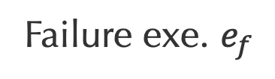
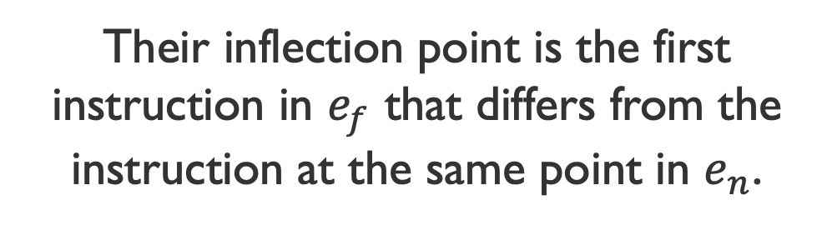
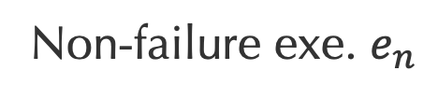
Inflection Point Hypothesis – Inflection Point
Their inflection point is the first instruction in $e_{f}$ that differs from the instruction at the same point in $e_{n}$.
Failure exe. $e_{f}$
Non-failure exe. $e_{n}$
if(CONFIG)
if(CONFIG)
a=0;
a=0;
a=-1;
if(a!=0)
if(a!=0)
a=-1;
FAIL;

Slide 21
Inflection Point Hypothesis – Inflection Point
Their inflection point is the first instruction in $e_{f}$ that differs from the instruction at the same point in $e_{n}$.
Failure exe. $e_{f}$
Non-failure exe. $e_{n}$
if(CONFIG)
if(CONFIG)
a=0;
a=0;
a=-1;
𝗫
if(a!=0)
if(a!=0)
a=-1;
FAIL;

Slide 22
Inflection Point Hypothesis – Inflection Point
Their inflection point is the first instruction in $e_{f}$ that differs from the instruction at the same point in $e_{n}$.
Failure exe. $e_{f}$
Non-failure exe. $e_{n}$
if(CONFIG)
if(CONFIG)
a=0;
a=0;
Common prefix
a=-1;
𝗫
if(a!=0)
if(a!=0)
a=-1;
FAIL;

Slide 23
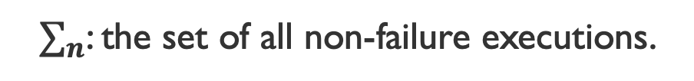
Inflection Point Hypothesis
Their inflection point is the first instruction in $e_{f}$ that differs from the instruction at the same point in $e_{n}$.
Failure exe. $e_{f}$
Non-failure exe. $e_{n}$
if(CONFIG)
if(CONFIG)
a=0;
a=0;
$∑_{n}$: the set of all non-failure executions.
Common prefix
a=-1;
𝗫
if(a!=0)
if(a!=0)
a=-1;
FAIL;

Slide 24
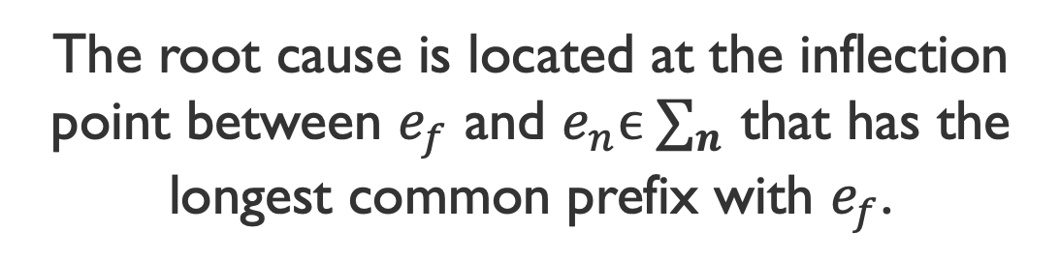
Inflection Point Hypothesis
Their inflection point is the first instruction in $e_{f}$ that differs from the instruction at the same point in $e_{n}$.
Failure exe. $e_{f}$
Non-failure exe. $e_{n}$
if(CONFIG)
if(CONFIG)
a=0;
a=0;
$∑_{n}$: the set of all non-failure executions.
Common prefix
a=-1;
𝗫
The root cause is located at the inflection point between $e_{f}$ and $e_{n}ϵ ∑_{n}$ that has the longest common prefix with $e_{f}$.
if(a!=0)
if(a!=0)
a=-1;
FAIL;

Slide 25
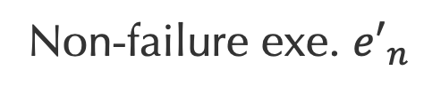
Inflection Point Hypothesis
Their inflection point is the first instruction in $e_{f}$ that differs from the instruction at the same point in $e_{n}$.
Failure exe. $e_{f}$
Non-failure exe. ${e′}_{n}$
𝗫
if(CONFIG)
if(CONFIG)
a=0;
a=0;
$∑_{n}$: the set of all non-failure executions.
Common prefix
a=-1;
The root cause is located at the inflection point between $e_{f}$ and $e_{n}ϵ ∑_{n}$ that has the longest common prefix with $e_{f}$.
if(a!=0)
if(a!=0)
FAIL;

Slide 26
Inflection Point Hypothesis
Their inflection point is the first instruction in $e_{f}$ that differs from the instruction at the same point in $e_{n}$.
Failure exe. $e_{f}$
Non-failure exe. $e_{n}$
if(CONFIG)
if(CONFIG)
a=0;
a=0;
$∑_{n}$: the set of all non-failure executions.
Common prefix
a=-1;
𝗫
The root cause is located at the inflection point between $e_{f}$ and $e_{n}ϵ ∑_{n}$ that has the longest common prefix with $e_{f}$.
if(a!=0)
if(a!=0)
a=-1;
FAIL;

Slide 27
Kairux – Automated Root Cause Localization
Construct the non-failure execution $e_{n}$ that has the longest common prefix.

Slide 28
Kairux – Automated Root Cause Localization
Construct the non-failure execution $e_{n}$ that has the longest common prefix.
Key ideas
Use unit tests

Slide 29
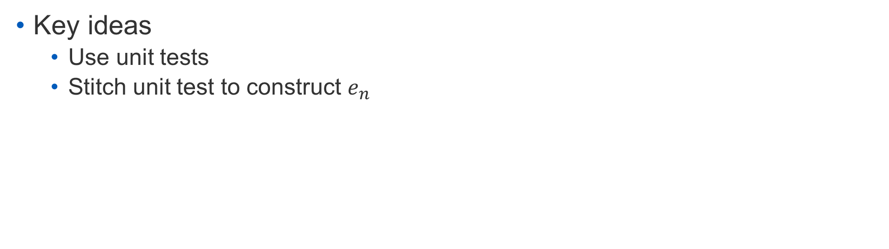
Kairux – Automated Root Cause Localization
Construct the non-failure execution $e_{n}$ that has the longest common prefix.
Key ideas
Use unit tests
Stitch unit test to construct $e_{n}$

Slide 30
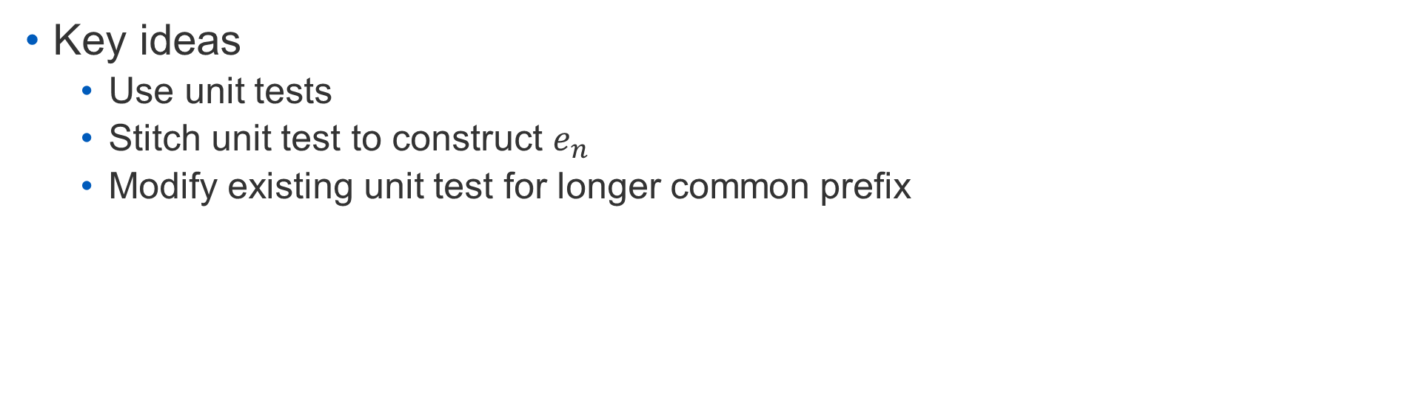
Kairux – Automated Root Cause Localization
Construct the non-failure execution $e_{n}$ that has the longest common prefix.
Key ideas
Use unit tests
Stitch unit test to construct $e_{n}$
Modify existing unit test for longer common prefix

Slide 31
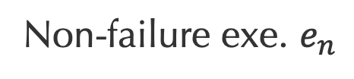
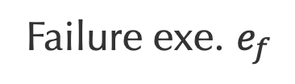
Kairux – Automated Root Cause Localization
Construct the non-failure execution $e_{n}$ that has the longest common prefix.
Failure exe. $e_{f}$
Non-failure exe. $e_{n}$
Key ideas
Use unit tests
Stitch unit test to construct $e_{n}$
Modify existing unit test for longer common prefix
if(CONFIG)
if(CONFIG)
a=0;
a=0;
a=-1;
if(a!=0)
if(a!=0)
a=-1;
FAIL;

Slide 32
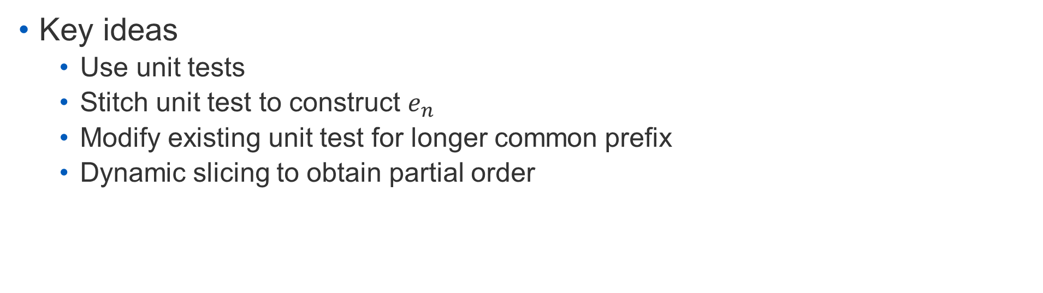
Kairux – Automated Root Cause Localization
Construct the non-failure execution $e_{n}$ that has the longest common prefix.
Key ideas
Use unit tests
Stitch unit test to construct $e_{n}$
Modify existing unit test for longer common prefix
Dynamic slicing to obtain partial order

Slide 33
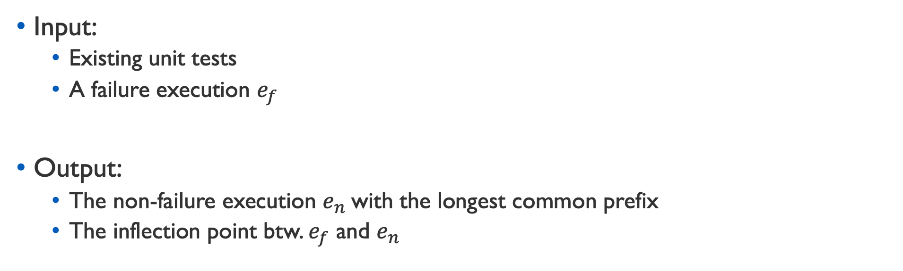
Kairux – Automated Root Cause Localization
Construct the non-failure execution $e_{n}$ that has the longest common prefix.
Input:
Existing unit tests
A failure execution $e_{f}$
Output:
The non-failure execution $e_{n}$with the longest common prefix
The inflection point btw. $e_{f}$ and $e_{n}$

Slide 34
Real-World Example – HDFS-10453
ReplicationMonitor thread
1. void replicateBlocks() {
2. for (Block b : neededReplications) {
3. int numNeeded = 3 - b.nReplica;
4. while(numNeeded > 0) {
5. node = chooseNextRandomNode(..);
6. if (b.size <= node.capacity) {
7. ... // replicate b to this node
8. numNeeded--;
9. }
10. }
11. if (numNeeded > 0)
12. throw new NotEnoughReplicasException();
13. }
14.}

Slide 35
Real-World Example – HDFS-10453
ReplicationMonitor thread
1. void replicateBlocks() {
2. for (Block b : neededReplications) {
3. int numNeeded = 3 - b.nReplica;
4. while(numNeeded > 0) {
5. node = chooseNextRandomNode(..);
6. if (b.size <= node.capacity) {
7. ... // replicate b to this node
8. numNeeded--;
9. }
10. }
11. if (numNeeded > 0)
12. throw new NotEnoughReplicasException();
13. }
14.}

Slide 36
Real-World Example – HDFS-10453
ReplicationMonitor thread
1. void replicateBlocks() {
2. for (Block b : neededReplications) {
3. int numNeeded = 3 - b.nReplica;
4. while(numNeeded > 0) {
5. node = chooseNextRandomNode(..);
6. if (b.size <= node.capacity) {
7. ... // replicate b to this node
8. numNeeded--;
9. }
10. }
11. if (numNeeded > 0)
12. throw new NotEnoughReplicasException();
13. }
14.}

Slide 37
Real-World Example – HDFS-10453
ReplicationMonitor thread
1. void replicateBlocks() {
2. for (Block b : neededReplications) {
3. int numNeeded = 3 - b.nReplica;
4. while(numNeeded > 0) {
5. node = chooseNextRandomNode(..);
6. if (b.size <= node.capacity) {
7. ... // replicate b to this node
8. numNeeded--;
9. }
10. }
11. if (numNeeded > 0)
12. throw new NotEnoughReplicasException();
13. }
14.}

Slide 38
Real-World Example – HDFS-10453
ReplicationMonitor thread
1. void replicateBlocks() {
2. for (Block b : neededReplications) {
3. int numNeeded = 3 - b.nReplica;
4. while(numNeeded > 0) {
5. node = chooseNextRandomNode(..);
6. if (b.size <= node.capacity) {
7. ... // replicate b to this node
8. numNeeded--;
9. }
10. }
11. if (numNeeded > 0)
12. throw new NotEnoughReplicasException();
13. }
14.}

Slide 39
Real-World Example – HDFS-10453
ReplicationMonitor thread
1. void replicateBlocks() {
2. for (Block b : neededReplications) {
3. int numNeeded = 3 - b.nReplica;
4. while(numNeeded > 0) {
5. node = chooseNextRandomNode(..);
6. if (b.size <= node.capacity) {
7. ... // replicate b to this node
8. numNeeded--;
9. }
10. }
11. if (numNeeded > 0)
12. throw new NotEnoughReplicasException();
13. }
14.}

Slide 40
Real-World Example – HDFS-10453
ReplicationMonitor thread
1. void replicateBlocks() {
2. for (Block b : neededReplications) {
3. int numNeeded = 3 - b.nReplica;
4. while(numNeeded > 0) {
5. node = chooseNextRandomNode(..);
6. if (b.size <= node.capacity) {
7. ... // replicate b to this node
8. numNeeded--;
9. }
10. }
11. if (numNeeded > 0)
12. throw new NotEnoughReplicasException();
13. }
14.}

Slide 41
Real-World Example – HDFS-10453
ReplicationMonitor thread
1. void replicateBlocks() {
2. for (Block b : neededReplications) {
3. int numNeeded = 3 - b.nReplica;
4. while(numNeeded > 0) {
5. node = chooseNextRandomNode(..);
6. if (b.size <= node.capacity) {
7. ... // replicate b to this node
8. numNeeded--;
9. }
10. }
11. if (numNeeded > 0)
12. throw new NotEnoughReplicasException();
13. }
14.}

Slide 42
Real-World Example – HDFS-10453
ReplicationMonitor thread
DeleteBlock thread
1. void replicateBlocks() {
2. for (Block b : neededReplications) {
3. int numNeeded = 3 - b.nReplica;
4. while(numNeeded > 0) {
5. node = chooseNextRandomNode(..);
6. if (b.size <= node.capacity) {
7. ... // replicate b to this node
8. numNeeded--;
9. }
10. }
11. if (numNeeded > 0)
12. throw new NotEnoughReplicasException();
13. }
14.}
15. void deleteBlock(Block blk) {
16. blk.size = Long.MAX_VALUE;
17. neededReplications.remove(blk);
18. }

Slide 43
Real-World Example – HDFS-10453
ReplicationMonitor thread
DeleteBlock thread
1. void replicateBlocks() {
2. for (Block b : neededReplications) {
3. int numNeeded = 3 - b.nReplica;
4. while(numNeeded > 0) {
5. node = chooseNextRandomNode(..);
6. if (b.size <= node.capacity) {
7. ... // replicate b to this node
8. numNeeded--;
9. }
10. }
11. if (numNeeded > 0)
12. throw new NotEnoughReplicasException();
13. }
14.}
15. void deleteBlock(Block blk) {
16. blk.size = Long.MAX_VALUE;
17. neededReplications.remove(blk);
18. }

Slide 44
Real-World Example – HDFS-10453
ReplicationMonitor thread
DeleteBlock thread
1. void replicateBlocks() {
2. for (Block b : neededReplications) {
3. int numNeeded = 3 - b.nReplica;
4. while(numNeeded > 0) {
5. node = chooseNextRandomNode(..);
6. if (b.size <= node.capacity) {
7. ... // replicate b to this node
8. numNeeded--;
9. }
10. }
11. if (numNeeded > 0)
12. throw new NotEnoughReplicasException();
13. }
14.}
15. void deleteBlock(Block blk) {
16. blk.size = Long.MAX_VALUE;
17. neededReplications.remove(blk);
18. }

Slide 45
Real-World Example – HDFS-10453
ReplicationMonitor thread
DeleteBlock thread
1. void replicateBlocks() {
2. for (Block b : neededReplications) {
3. int numNeeded = 3 - b.nReplica;
4. while(numNeeded > 0) {
5. node = chooseNextRandomNode(..);
6. if (b.size <= node.capacity) {
7. ... // replicate b to this node
8. numNeeded--;
9. }
10. }
11. if (numNeeded > 0)
12. throw new NotEnoughReplicasException();
13. }
14.}
15. void deleteBlock(Block blk) {
16. blk.size = Long.MAX_VALUE;
17. neededReplications.remove(blk);
18. }

Slide 46
Real-World Example – HDFS-10453
ReplicationMonitor thread
DeleteBlock thread
if (storage.getStorageType() != storageType) { return false; } if (storage.getState() == State.READ_ONLY_SHARED) { return false; } DatanodeDescriptor node = storage.getDatanodeDescriptor(); // check if the node is (being) decommissioned if (node.isDecommissionInProgress() || node.isDecommissioned()) { return false; } if (avoidStaleNodes) { if (node.isStale(this.staleInterval)) { return false; } } final long requiredSize = blockSize * HdfsConstants.MIN_BLOCKS_FOR_WRITE; final long scheduledSize = blockSize * node.getBlocksScheduled(); if (requiredSize > node.getRemaining() - scheduledSize) { return false; } // check the communication traffic of the target machine if (considerLoad) { double avgLoad = 0; if (stats != null) { int size = stats.getNumDatanodesInService(); if (size != 0) { avgLoad = (double)stats.getTotalLoad()/size; } } if (node.getXceiverCount() > (2.0 * avgLoad)) { return false; } }
1. void replicateBlocks() {
2. for (Block b : neededReplications) {
3. int numNeeded = 3 - b.nReplica;
4. while(numNeeded > 0) {
5. node = chooseNextRandomNode(..);
15. void deleteBlock(Block blk) {
16. blk.size = Long.MAX_VALUE;
17. neededReplications.remove(blk);
18. }
6. if (b.size <= node.capacity) {
7. ... // replicate b to this node
8. numNeeded--;
9. }
10. }
11. if (numNeeded > 0)
12. throw new NotEnoughReplicasException();
13. }
14.}

Slide 47
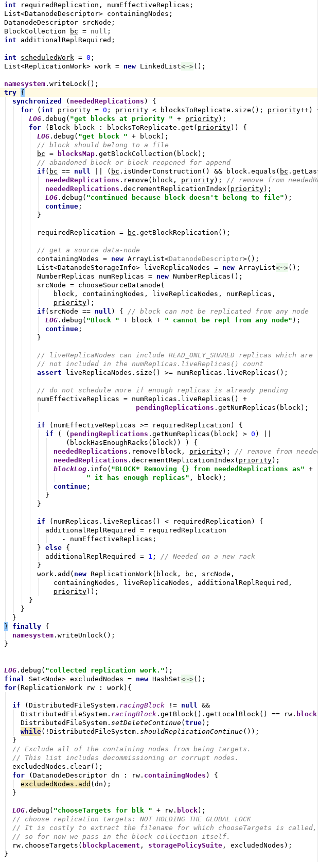
Real-World Example – HDFS-10453
1. void replicateBlocks() {
2. for (Block b : neededReplications) {
3. int numNeeded = 3 - b.nReplica;
4. while(numNeeded > 0) {
5. node = chooseNextRandomNode(..);
if (storage.getStorageType() != storageType) { return false; } if (storage.getState() == State.READ_ONLY_SHARED) { return false; } DatanodeDescriptor node = storage.getDatanodeDescriptor(); // check if the node is (being) decommissioned if (node.isDecommissionInProgress() || node.isDecommissioned()) { return false; } if (avoidStaleNodes) { if (node.isStale(this.staleInterval)) { return false; } } final long requiredSize = blockSize * HdfsConstants.MIN_BLOCKS_FOR_WRITE; final long scheduledSize = blockSize * node.getBlocksScheduled(); if (requiredSize > node.getRemaining() - scheduledSize) { return false; } // check the communication traffic of the target machine if (considerLoad) { double avgLoad = 0; if (stats != null) { int size = stats.getNumDatanodesInService(); if (size != 0) { avgLoad = (double)stats.getTotalLoad()/size; } } if (node.getXceiverCount() > (2.0 * avgLoad)) { return false; } }
6. if (b.size <= node.capacity) {
7. ... // replicate b to this node
8. numNeeded--;
9. }
10. }
11. if (numNeeded > 0)
12. throw new NotEnoughReplicasException();
13. }
14.}

Slide 48
Real-World Example – HDFS-10453
HDFS Cluster
ReplicationMonitor thread
DeleteBlock thread

Slide 49
Real-World Example – HDFS-10453
Repeatedly reproduced
Numerous printf debugging rounds
One month to diagnose
HDFS Cluster
ReplicationMonitor thread
DeleteBlock thread

Slide 50
Real-World Example – HDFS-10453
ReplicationMonitor thread
DeleteBlock thread
1. void replicateBlocks() {
2. for (Block b : neededReplications) {
3. int numNeeded = 3 - b.nReplica;
4. while(numNeeded > 0) {
5. node = chooseNextRandomNode(..);
6. if (b.size <= node.capacity) {
7.
8. numNeeded--;
9. }
10. }
11. if (numNeeded > 0)
12. throw new NotEnoughReplicasException();
13. }
14.}
15. void deleteBlock(Block blk) {
16. blk.size = Long.MAX_VALUE;
17.
18. }
HDFS Cluster
ReplicationMonitor thread
DeleteBlock thread

Slide 51
Real-World Example – HDFS-10453
ReplicationMonitor thread
DeleteBlock thread
1. void replicateBlocks() {
2. for (Block b : neededReplications) {
3. int numNeeded = 3 - b.nReplica;
4. while(numNeeded > 0) {
5. node = chooseNextRandomNode(..);
6. if (b.size <= node.capacity) {
7.
8. numNeeded--;
9. }
10. }
11. if (numNeeded > 0)
12. throw new NotEnoughReplicasException();
13. }
14.}
15. void deleteBlock(Block blk) {
16. blk.size = Long.MAX_VALUE;
17.
18. }

Slide 52
Real-World Example – HDFS-10453
ReplicationMonitor thread
DeleteBlock thread
1. void replicateBlocks() {
2. for (Block b : neededReplications) {
3. int numNeeded = 3 - b.nReplica;
4. while(numNeeded > 0) {
5. node = chooseNextRandomNode(..);
6. if (b.size <= node.capacity) {
7.
8. numNeeded--;
9. }
10. }
11. if (numNeeded > 0)
12. throw new NotEnoughReplicasException();
13. }
14.}
15. void deleteBlock(Block blk) {
16. blk.size = Long.MAX_VALUE;
17.
18. }
testChangeColdRep
createFile("/foo”,3);
setReplication("/foo",5);

Slide 53
Real-World Example – HDFS-10453
ReplicationMonitor thread
DeleteBlock thread
1. void replicateBlocks() {
2. for (Block b : neededReplications) {
3. int numNeeded = 3 - b.nReplica;
4. while(numNeeded > 0) {
5. node = chooseNextRandomNode(..);
6. if (b.size <= node.capacity) {
7.
8. numNeeded--;
9. }
10. }
11. if (numNeeded > 0)
12. throw new NotEnoughReplicasException();
13. }
14.}
15. void deleteBlock(Block blk) {
16. blk.size = Long.MAX_VALUE;
17.
18. }
testChangeColdRep
createFile("/foo”,3);
setReplication("/foo",5);

Slide 54
Real-World Example – HDFS-10453
ReplicationMonitor thread
DeleteBlock thread
1. void replicateBlocks() {
2. for (Block b : neededReplications) {
3. int numNeeded = 3 - b.nReplica;
4. while(numNeeded > 0) {
5. node = chooseNextRandomNode(..);
6. if (b.size <= node.capacity) {
7.
8. numNeeded--;
9. }
10. }
11. if (numNeeded > 0)
12. throw new NotEnoughReplicasException();
13. }
14.}
15. void deleteBlock(Block blk) {
16. blk.size = Long.MAX_VALUE;
17.
18. }
testChangeColdRep
createFile("/foo”,3);
setReplication("/foo",5);
testRemove
createFile("/foo”,3);
deleteFile("/foo");

Slide 55
Real-World Example – HDFS-10453
ReplicationMonitor thread
DeleteBlock thread
1. void replicateBlocks() {
2. for (Block b : neededReplications) {
3. int numNeeded = 3 - b.nReplica;
4. while(numNeeded > 0) {
5. node = chooseNextRandomNode(..);
6. if (b.size <= node.capacity) {
7.
8. numNeeded--;
9. }
10. }
11. if (numNeeded > 0)
12. throw new NotEnoughReplicasException();
13. }
14.}
15. void deleteBlock(Block blk) {
16. blk.size = Long.MAX_VALUE;
17.
18. }
combinedTest
createFile("/foo”,3);
setReplication("/foo",5);
deleteFile("/foo");

Slide 56
Real-World Example – HDFS-10453
ReplicationMonitor thread
DeleteBlock thread
1. void replicateBlocks() {
2. for (Block b : neededReplications) {
3. int numNeeded = 3 - b.nReplica;
4. while(numNeeded > 0) {
5. node = chooseNextRandomNode(..);
6. if (b.size <= node.capacity) {
7.
8. numNeeded--;
9. }
10. }
11. if (numNeeded > 0)
12. throw new NotEnoughReplicasException();
13. }
14.}
15. void deleteBlock(Block blk) {
16. blk.size = Long.MAX_VALUE;
17.
18. }
Root Cause
combinedTest
createFile("/foo”,3);
setReplication("/foo",5);
deleteFile("/foo");

Slide 57
Evaluation
Evaluated Kairux on 10 cases from JVM distributed systems
HDFS, HBase, ZooKeeper
One case with noisy operations generated from manual reproduction

Slide 58
Effectiveness of Kairux
Successfully finds inflection points for 7
3 unsuccessful cases:
root cause location cannot be reached by modifying unit tests
Reduces the # of instructions to diagnose
 | # instr. in dynamic slice | # instr. in longest prefix | # tests combined
Avg. | 309 | 165 | 1.43

Slide 59
Effectiveness of Kairux
Successfully finds inflection points for 7
3 unsuccessful cases:
root cause location cannot be reached by modifying unit tests
Reduces the # of instructions to diagnose
 | # instr. in dynamic slice | # instr. in longest prefix | # tests combined
Avg. | 309 | 165 | 1.43

Slide 60
Related Work
Statistical debugging
Delta Debugging
Hybrid approaches
Triage: deterministic replay + statistical debugging
Failure Sketching: hardware (Intel-PT) + statistical debugging

Slide 61
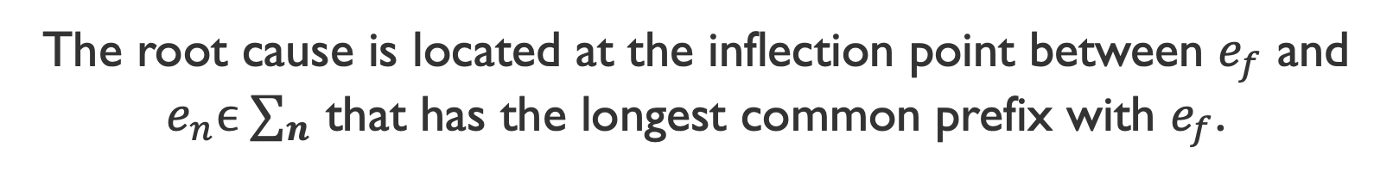
Conclusion
Inflection Point Hypothesis: Enables Principled Search for Root Cause
Kairux: transforms the inflection point hypothesis to a practical tool
Kairux is effective in locating root cause in real distributed system failures
The root cause is located at the inflection point between $e_{f}$ and $e_{n}ϵ ∑_{n}$ that has the longest common prefix with $e_{f}$.
Thanks!

Slide 62
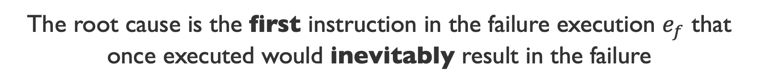
Refined Definition of Root Cause
The root cause is the first instruction in the failure execution $e_{f}$ that once executed would inevitably result in the failure

Slide 63
Caveats
Identifying root cause is subjective.
Thread 0
Thread 1
Time
if(CONFIG)
a=0;
a=-1;
if(a!=0)
FAIL;

